Slide 1
Doubly linked list

Slide 2
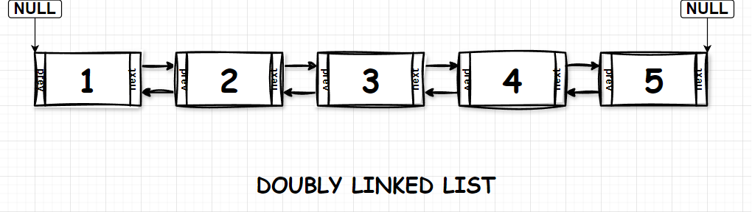
A doubly linked list or a two-way linked list is a more complex type of linked list that contains a pointer to the next as well as the previous node in sequence.

Slide 3
Insert front

Slide 4
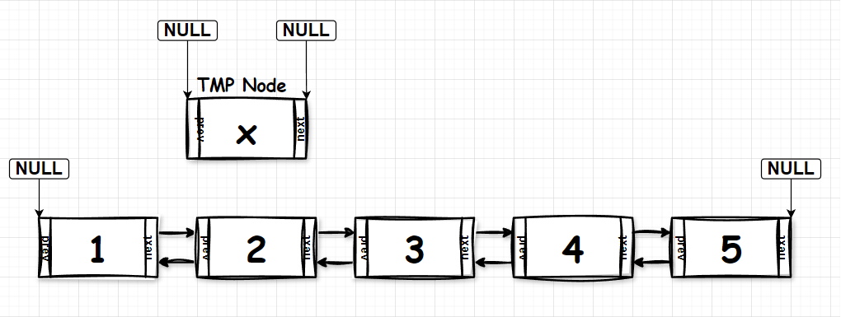
We need a temponary node that will be the node we add into the list

Slide 5
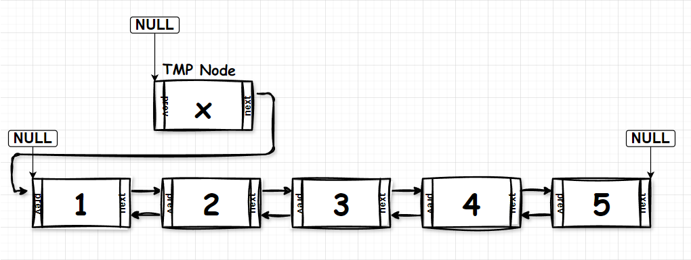
Make the TMP’s next pointer point to the 1st node in the list

Slide 6
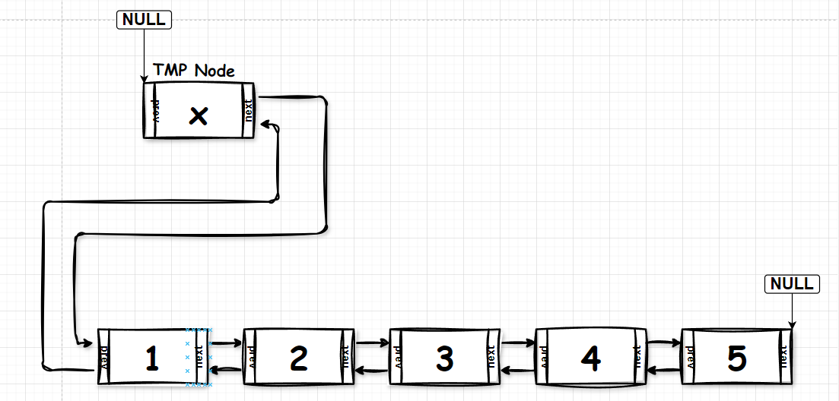
Then make the 1st’s prev pointer point to TMP node, every things will be done !!!

Slide 7
Insert back

Slide 8
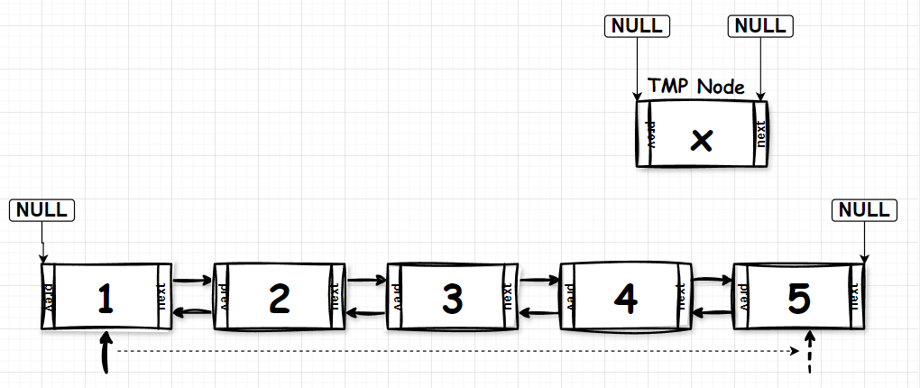
We need a temponary node that will be the node we add into the list, also use another pointer to browse for the last node(if you use the current pointer that pointer to the list to browse, you’ll lose all tracks of the prev node)

Slide 9
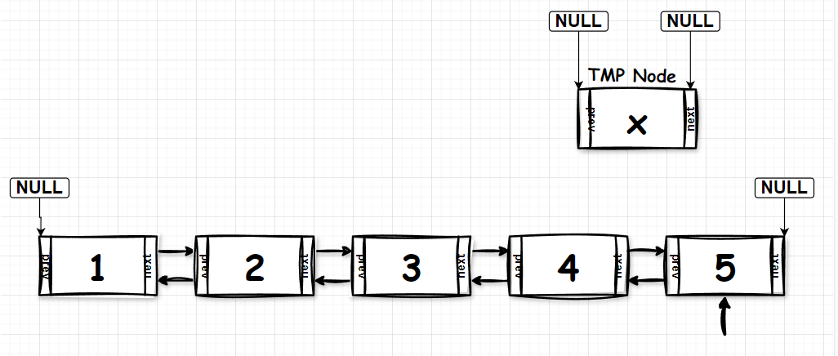
Now, we have the last node, do like what you do before, link the TMP Node to the last node, easy peasy !!

Slide 10
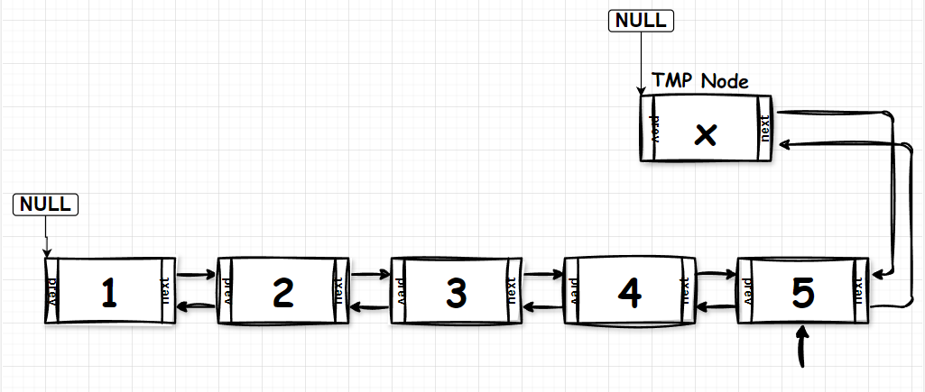
Now, we have the last node, do like what you do before, link the TMP Node to the last node, easy peasy !!

Slide 11
Insert middle

Slide 12
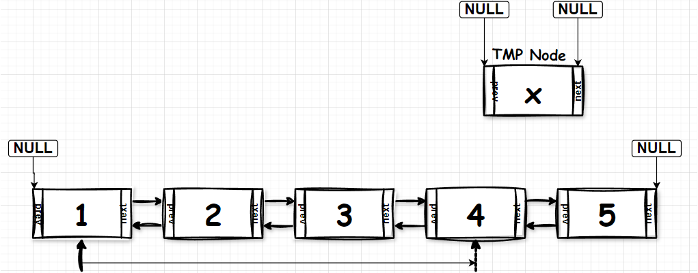
We use a pointer to browse for the pos that you want to insert new node(if you use the current pointer that pointer to the list to browse, you’ll lose all tracks of the prev node), for example, I want to insert at pos = 4, use the pointer move it from 1st node to 4th node

Slide 13
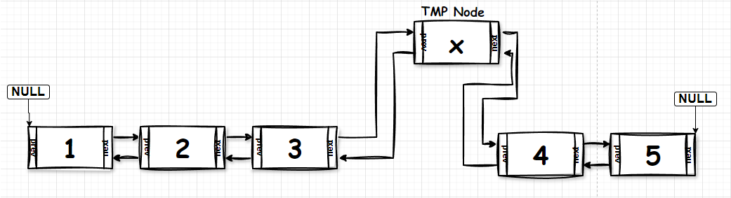
Now, link the TMP’s next pointer to 4th node and 3rd Node’s next pointer to the TMP Node, done : D!!!!!!!!!

Slide 14
Delete middle

Slide 15
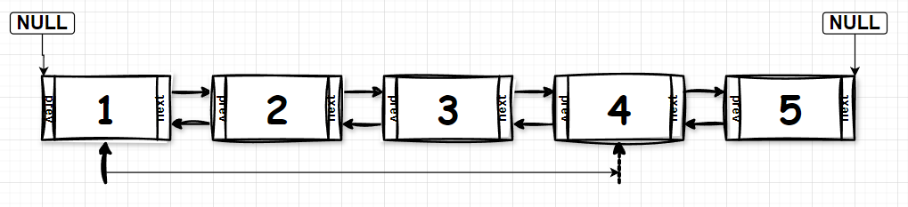
We use a pointer to browse for the pos that you want to delete node(if you use the current pointer that pointer to the list to browse, you’ll lose all tracks of the prev node), for example, I want to delete node at pos = 4, use the pointer move it from 1st node to 4th node

Slide 16
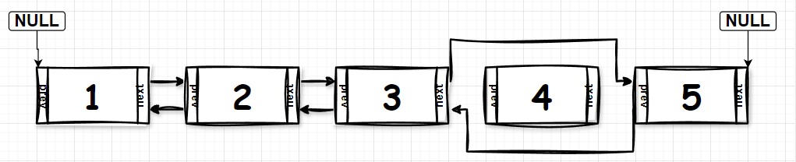
Now so easy, just unlink the prev node and the next node from the node you want to delete, then link them together

Slide 17
I think delete front and delete back kinda easy : DDDD so maybe no visualization : DDD

